Slide 1
Lean Project Spring 2025 Team: 4 EverCharge Zach Haley Michael Fortin Saheel Chaveen Jenny Patel Naveen Murali

Slide 2
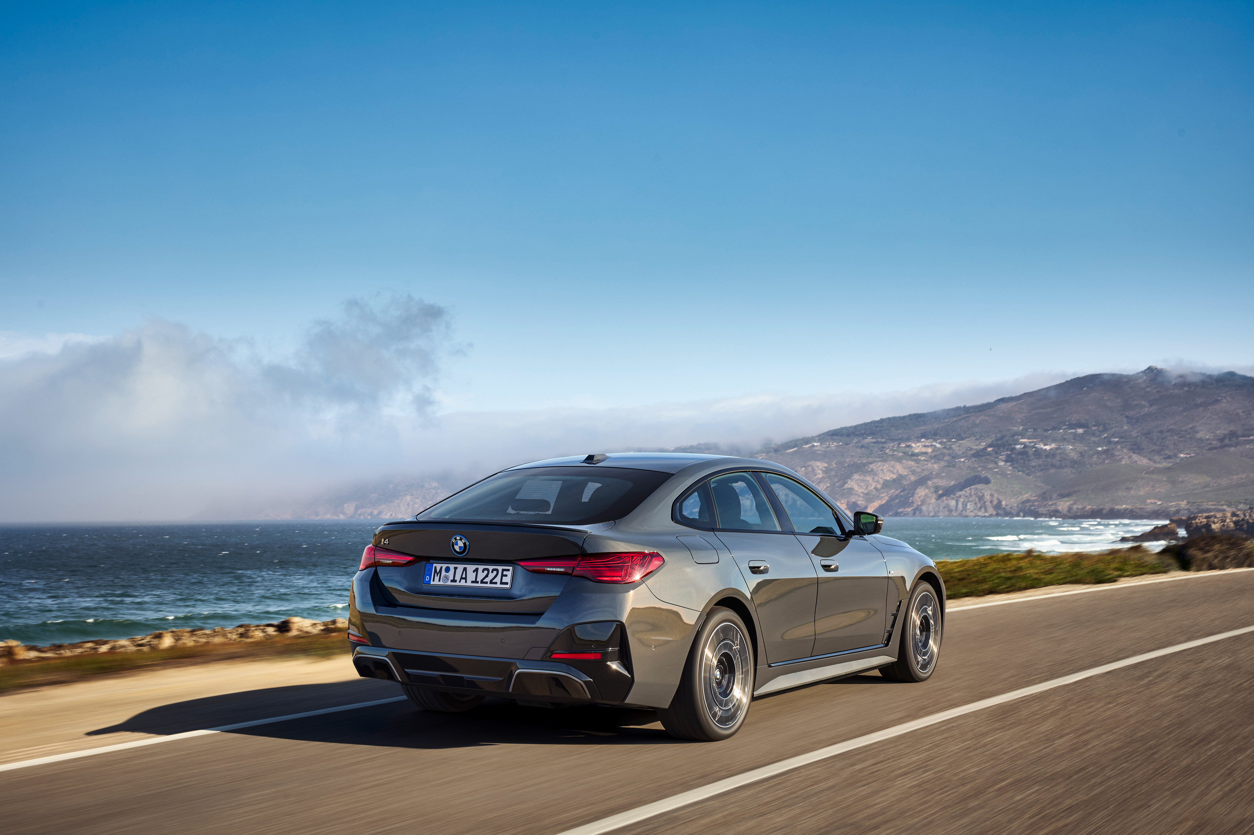
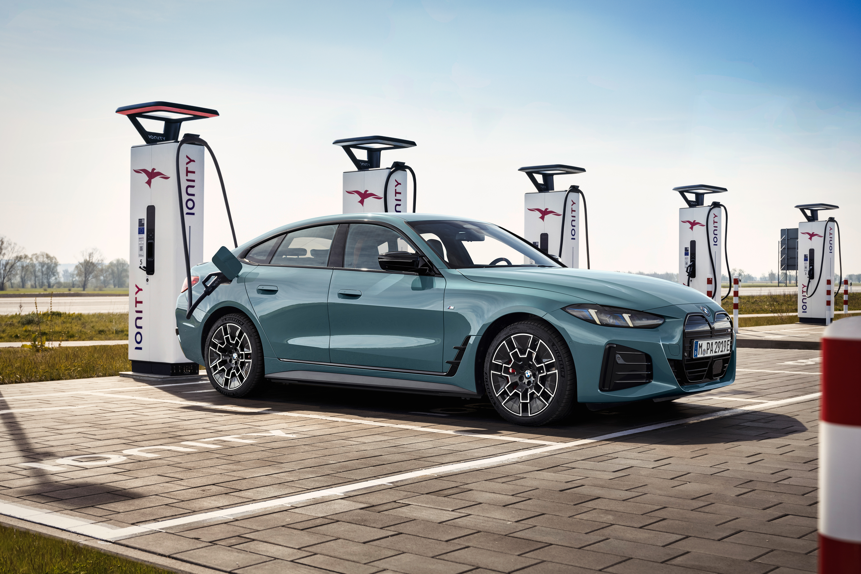
Part 1: Electric Vehicle (EV) Industry Overview

Slide 3
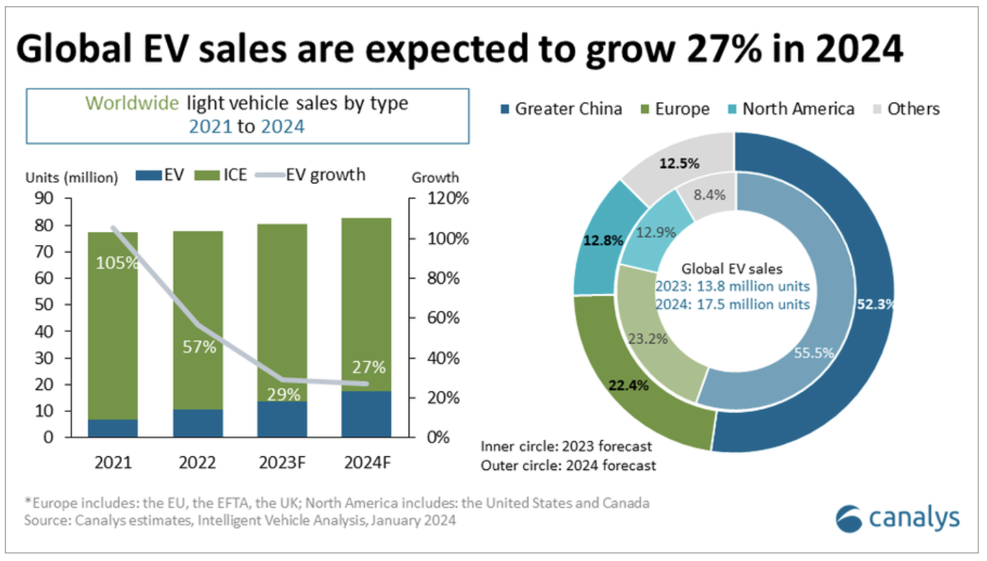
Industry Overview
EV industry valued at ~670 billion in 2024, including 17.5 million vehicles sold in the last year
Biggest EV charging companies include Tesla, Chargepoint, & EVgo
10-year growth includes:
Automobile market share from .4% to 25%
300K EVs sold to 17.5 Million
Charging stations primarily only installed
at homes and now have over a million
world-wide which includes 207,000 public
charging stations in the US alone

Slide 4
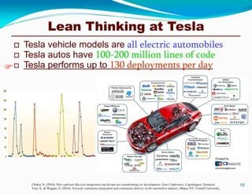
Industry Main Challenges: Last 10 Years
Main challenges have faced with in the last 10 years include:
Government policy & regulation
Supply Chain issues
Lagging infrastructure to handle high volume of charging stations
Overall cost
'Range Anxiety'
Goal of improvements include:
Increase EV battery life
Increase EV infrastructure
Decrease charging time

Slide 5
Example of a Lean Incentive Accomplished in Last 10 years
What was done
Utilized lean techniques such as Just-in-Time, 5S, Kaizen, & Value Stream Mapping
Measurable Results from industry leader Tesla
Gigafactories increased production by 1.3 million in 8 years
Redesign of production lines saw 30% decrease in costs; increase in production
Reduced Model Y's number of parts in its underbody from 70 to 2
Lessons Learned
Utilizing entire supply chain leads to more efficiency, less waste
Implement lean at the design phase
Lean starts with culture
Next Steps
Continue to apply lean to entire supply chain & adapt to customer demand

Slide 6
Current Challenges and Areas for Lean Improvement
Current challenges in industry for lean improvement:
Supply chain volatility
Scaling production while maintaining quality
Lack of standardization due to complexity of batteries
Skill gaps & lack of training
Areas for lean improvement:
Utilize lean in entire supply chain
Increase standardization
Utilize training programs
Identify practical ways to recycle and re-use batteries through continous improvement

Slide 7

Part 2: Proposal for EverCharge

Slide 8
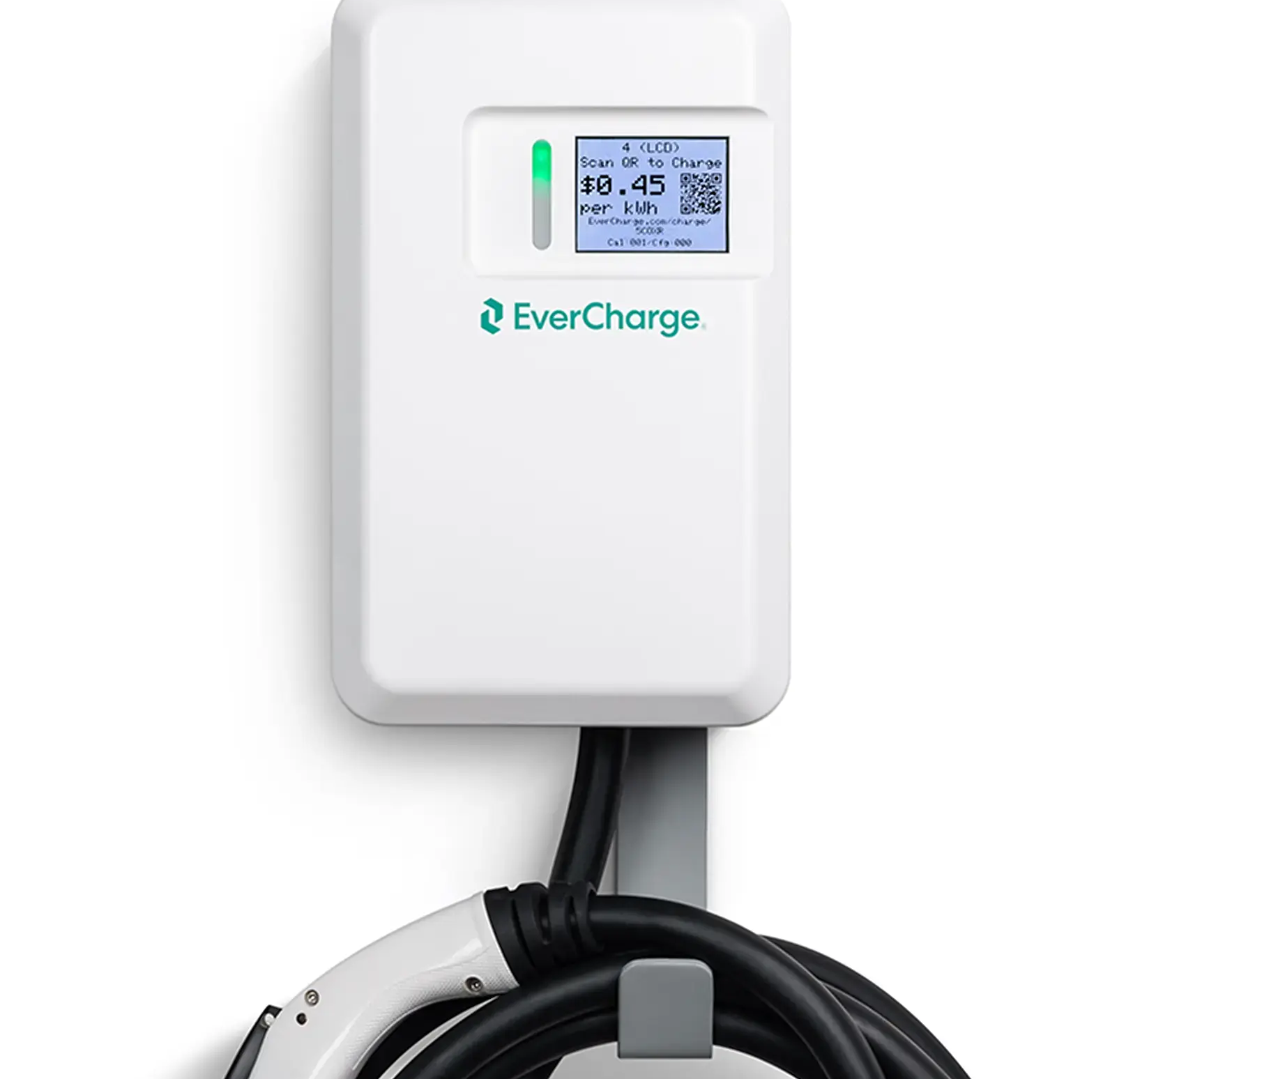
Company Overview
• Founded in 2013, Palo Alto-based EV charging startup
• SmartPower™ tech allows more chargers without upgrades
• Acquired by SK Group in 2022
• Offers full-stack charging solutions: assessment to service
Focused on scalable, energy-efficient infrastructure

Slide 9
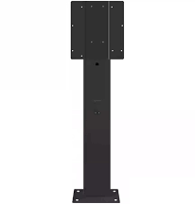

Current Challenges and Areas for Lean Improvement
Two Types of Challenges:
Challenge we tackled:
Employee motivation
Lots of small breaks
65% overall Utilization
Creating a team environment
Areas for Line-side Lean Improvement:
Station 6 → Large bottleneck
Currently being dealt with by process engineer @ Evercharge
Pedestal Line → Logistics issue
Macroeconomic issue outside of scope

Slide 10
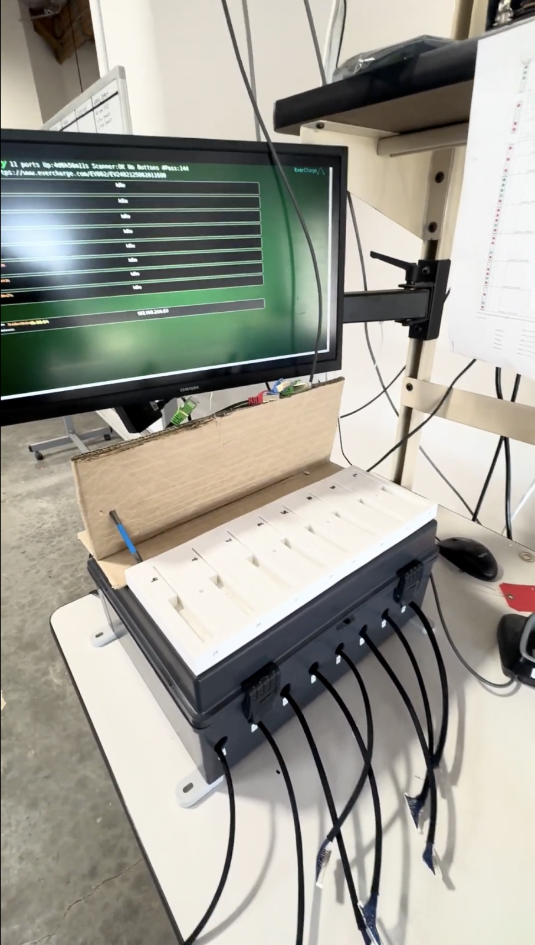
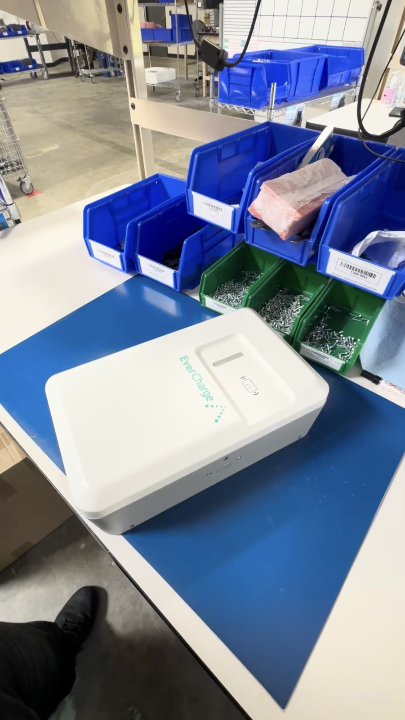
Current Challenges and Areas for Lean Improvement
Goals of improvement:
Foster Employee Motivation
Increase Utilization by 5-10% in the first three month (pilot)
Provide a basis for improvement with the advent of increased orders coming in 2025

Slide 11
Proposed Lean Project: “What”
Consistency and hitting targets → rewarded
Visibility increases accountability
Group events, meals paid for, kind gestures go a long way for employees
Proposed Solution (3-fold)
Output based payment plan for the 7 technicians
Installation of a large monitor at the front of the production area
Employee appreciation program

Slide 12
Proposed Lean Project: “How Much”
Budget Highlights
$1,200 – Internet + network upgrade
Free – Large display for real-time metrics
$2,000 – Incentive & recognition program
$500 – Technician training workshops
$1,000 – Contingency buffer
$15,000 – Opportunity Cost
Total Estimated Budget: $19,700
Human Resources
IT technician, factory manager, line supervisors, technicians
Physical Resources
Testing fixture, 1 display unit, networking tools, training material
Timeline
Preparation & Setup: 2 weeks
Implementation & Launch: 2 weeks
Monitoring & evaluation: Ongoing (3 months)

Slide 13
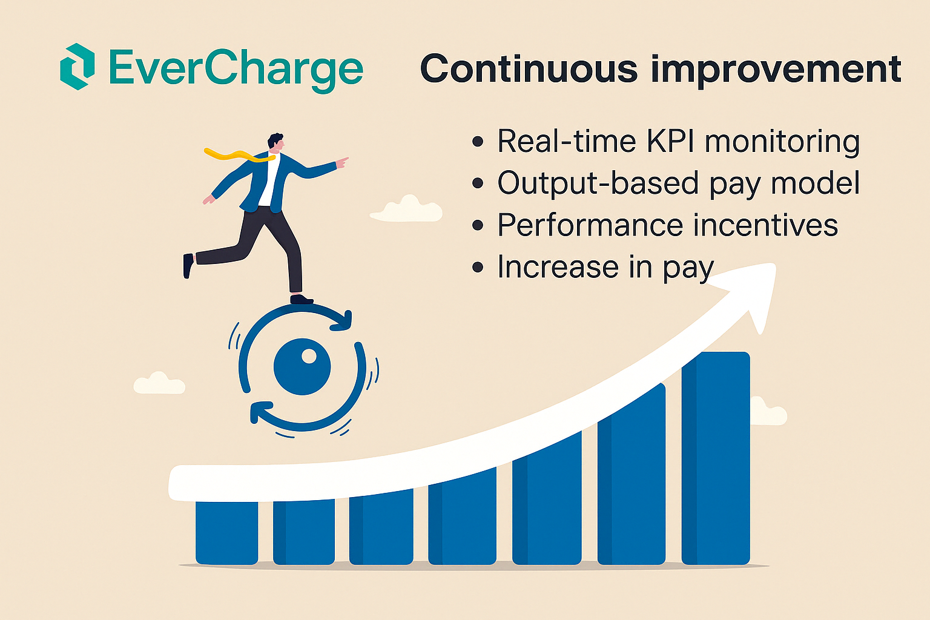
Steps for Continuous Improvement
Proposed Changes for improvement include:
Real time KPI monitoring to track Takt time and output against daily goals to maintain consistent production flow.
Output based compensation model to motivate employees to reach weekly target.
The new compensation model is expected to boost weekly output from 160 to 170–180 units.
Future enhancements also include an increase in pay, to encourage employee retention and boost culture of ownership in productivity.

Slide 14
References
Axios (2025). EV Charging Infrastructure Update. Available at: https://www.axios.com/newsletters/axios-san-francisco-f752d200-d4f9-11ef-a4ac-d54bf74b02a8
PwC (2024). Electric Vehicle Charging Market Growth Analysis. Available at: https://www.pwc.com/us/en/industries/industrial-products/library/electric-vehicle-charging-market-growth.html
The Verge (2024). Next-Generation EV Charging Speeds. Available at: https://www.theverge.com/news/619345/volvo-es90-range-battery-charging-ev-voltage
Virta Global (2025). Future of EV Charging Infrastructure. Available at: https://www.virta.global/blog/the-year-of-the-ev-what-2025-holds-for-electric-vehicles-and-emobility

